Slide 1

INSTITUTE UIE
DEPARTMENT ACADEMIC UNIT-1
Bachelor of Engineering (Computer Science & Engineering)
Subject Name Basic Electrical & Electronics Engineering
Subject Code 21ELH-101
Prepared By
Akhil Nigam
Unit-1 Chapter-1
Introduction to DC & AC Circuit
Lecture No. 1
DISCOVER . LEARN . EMPOWER

Slide 2
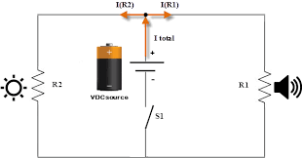
Lecture Objectives
S. No. | Objectives
1 | To make student aware about the basic concept of ac and dc circuits.
2 | To aware about need of electricity.
3 | To provide knowledge about types of supply and difference between them.
4 | To make familiar with types of sources.
5 | To give brief knowledge about ohm’s law and its limitations.
https://library.automationdirect.com/basic-electrical-theory/

Slide 3
Course Objectives
S. No. | Objectives
1 | To meet students with basic knowledge of dc circuits, electromagnetism and ac fundamentals.
2 | To aware about introduction to single and three phase ac circuit with their construction and working principles.
3 | To provide knowledge about electrical and electronics engineering fundamentals.
4 | To acquire specific knowledge skills so as to comprehend how electric, magnetic and electronic circuits are applied in practice.
https://library.automationdirect.com/basic-electrical-theory/

Slide 4
Course Outcomes
CO Number | Title | Level
CO1 | Identify the different types of electrical elements and the basic op-amp circuit elements and to illustrate the various types of motors, transducers and batteries. | Remember
CO2 | Understand basic principles of transformers, transducers, op-amps, DC and AC motors and to compare the different methods for analyzing electrical and magnetic circuits. | Understand
CO3 | Derive the relationships between parameters in electric and magnetic circuits and motors and to determine specifications of op-amps. | Analyze
CO4 | Solve the basic problems related to electric circuits, magnetic circuits and motors and to assess the characteristics of different configurations of op-amps. | Evaluate
CO5 | Design the different applications of transducers, motors as well as the op-amps like adders, subtractor and comparators. | Create
https://library.automationdirect.com/basic-electrical-theory/

Slide 5
Importance of Basic Electrical & Electronics Engineering
Use from home appliances to industrial plants.
Usage in communication and satellite navigation system.
Handles in electronics equipment and computers.
Deals with the problem of power transmission and motor control.
Control and monitor the medical appliances in hospitals.
High voltage applications with heavy current.
Robotics applications.
Product designing and development.

Slide 6
Content
Why we need electricity ?
Basic introduction to different electrical elements.
Types of elements.
Types of supply.
Difference between ac & dc supply.
Types of sources.
Advantages of AC over DC supply.
What is ohm’s law?
Limitations of ohm’s law.

Slide 7
Why We Need Electricity?
Electricity is the most versatile and easily controlled form of energy. At the point of use it is practically loss-free and essentially non-polluting.
Electricity is weightless, easier to transport and distribute, and it represents the most efficient way of consuming energy.
Electricity is needed to turn computers, refrigerators, televisions and all other electrical objects to work.
Electricity is also further required to operate electrical vehicles.

Slide 8
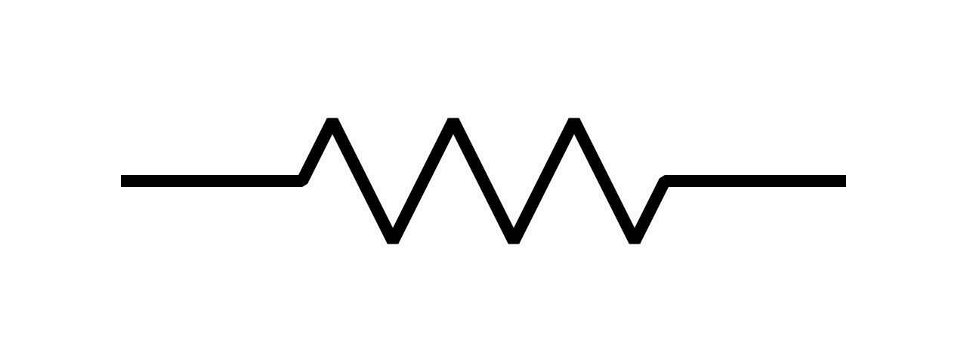
Basic Electrical Elements
Resistance: Resistance is a measure of the opposition to current flow in an electrical circuit. Resistance is measured in ohms.
Resistance is the opposition that a substance offers to the flow of electric current.
When an electric current of one ampere passes through a component across which a potential difference (voltage) of one volt exists, then the resistance of that component is one ohm.
Fig.1 resistance
https://commons.wikimedia.org/wiki/File:Resistor_symbol_America.svg

Slide 9

Basic Electrical Elements
Inductance: An inductor is an energy storage device which stores energy in form of magnetic field and its property is called inductance. It is measured in henry.
A current generated in a conductor by a changing magnetic field is proportional to the rate of change of the magnetic field.
This effect is called INDUCTANCE and is given the symbol L.
Fig.2 inductance
https://www.electronics-notes.com/articles/basic_concepts/inductance/inductance-basics-tutorial.php

Slide 10
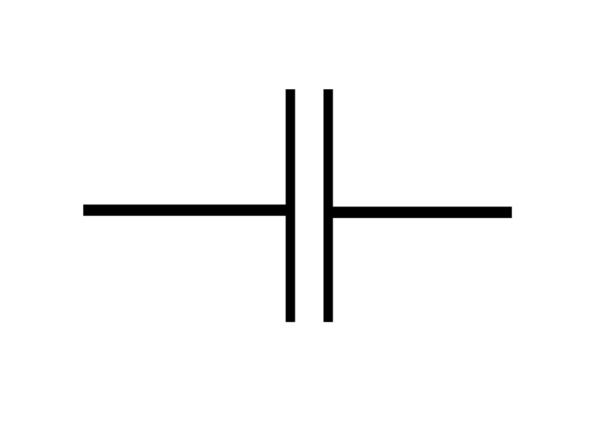
Basic Electrical Elements
Capacitance: Capacitance is defined as being that a capacitor has the capacitance of One Farad when a charge of One Coulomb is stored on the plates by a voltage of One volt.
Consist of two parallel conductive plates (usually a metal) which are prevented from touching each other (separated) by an insulating material called the “dielectric”.
The unit of capacitance is Farad.
Fig.3 capacitance
https://www.stitchingworlds.net/experimentation/measuring-textile-capacitors/

Slide 11
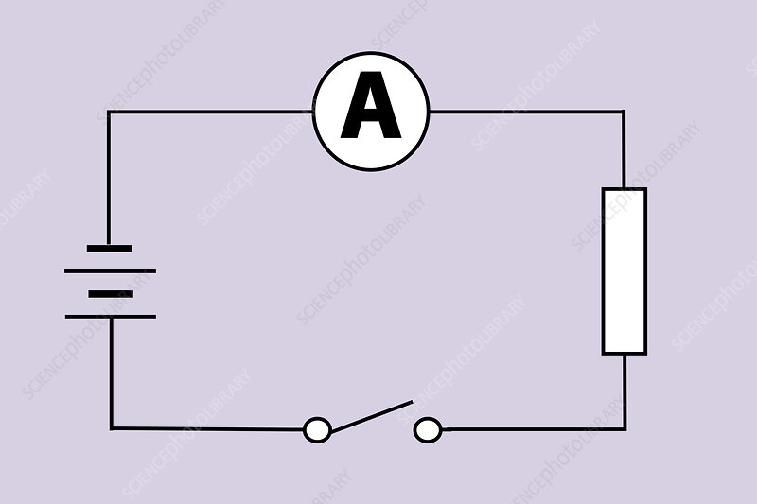
Basic Electrical Elements
Current: The electric current is the rate of flow of electric charge through a conducting medium with respect to time.
It is represented by I and its unit is in Ampere.
One ampere of current is defined as one coulomb of electrical charge moving past a unique point in a second.
Fig.4 current
https://www.sciencephoto.com/media/346768/view/measuring-electric-current

Slide 12
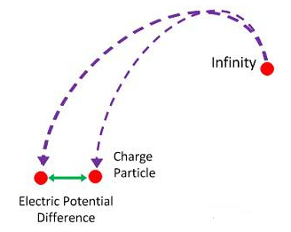
Basic Electrical Elements
Electric Potential Difference: It is defined as the amount of work done to carrying a unit charge from one point to another in an electric field.
In other words, the potential difference is defined as the difference in the electric potential of the two charged bodies.
Unit is in volt.
Fig.5 electric potential difference
https://circuitglobe.com/electric-potential-and-potential-difference.html

Slide 13
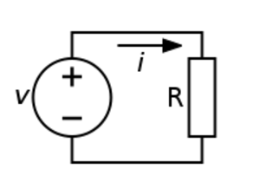
Basic Electrical Elements
Voltage: It is electric potential energy per unit charge, measured in joules per coulomb ( = volts).
It is often referred to as "electric potential“.
Voltage is the measure of work required to move a unit charge from one location to another, against the force which tries to keep electric charges balanced.
Fig. 6 voltage
https://en.wikipedia.org/wiki/Voltage_source

Slide 14
Types of Elements
Active Element
Passive Element
Linear Element
Non-Linear Element
Unilateral Element
Bi-lateral Element

Slide 15
Definitions of Elements
Active Element: These are those elements which have their own source of energy mean that it does not need any external source of energy.
Exmp. voltage source, current source, transistors
Passive Element: These are those elements which have not their own source of energy mean that it needs any external source of energy.
Exmp. Resistance, inductance, capacitance

Slide 16
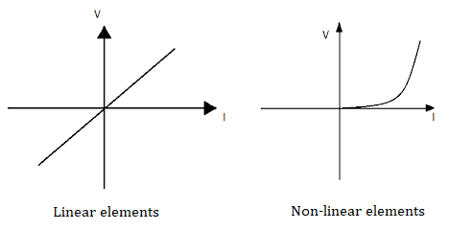
Definitions of Elements
Linear Element: These are those elements which have constant characteristics or which shows linear graph.
Exmp. Resistor, capacitor, inductor
Non-linear Element: These are those elements which do not have constant characteristics or which shows non- linear graph.
Exmp. transistors, vacuum tubes
Fig. 7 linear and non-linear element
https://bornoporichoystudycenter.blogspot.com/2017/07/electric-circuit-and-network-theorem.html#:~:text=they%20are%20not%20change%20with%20voltage%20and%20current.%20i.e.%20An

Slide 17
Definitions of Elements
Unilateral Element: These are those elements in which conduction of current is in one direction only is termed as unilateral element.
Exmp. Diode, Transistor
Bilateral Element: These are those elements in which conduction of current is in both directions in an element with same magnitude is termed as bilateral element.
Exmp. Resistance; Inductance; Capacitance

Slide 18
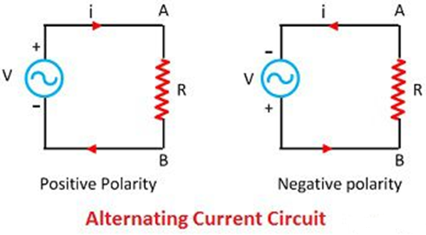
Types of Supply
AC Supply: It is referred as alternating current.
The current that changes its magnitude and polarity at regular intervals of time is called an alternating current.
The major advantage of using the alternating current instead of direct current is that the alternating current is easily transformed from higher voltage level to lower voltage level.
Fig. 8 ac supply
https://circuitglobe.com/alternating-current-ac.html

Slide 19
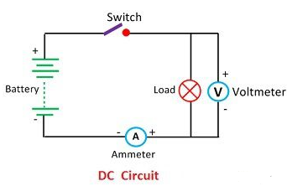
Types of Supply
DC Supply: It is referred as direct current. The current which have same magnitude and polarity at all time is called direct current.
Direct current is the unidirectional flow of an electric charge. An electrochemical cell is a prime example of DC power.
It may flow through a conductor for eaxmples semiconductors, insulators, or even through a vacuum as in electron.
Fig. 9 dc supply
https://circuitglobe.com/dc-circuit.html

Slide 20
Difference Between AC and DC Supply
Parameters | AC Supply | DC Supply
Definition | The direction of the current reverse periodically. | The direction of the current remain same.
Frequency | 50 or 60 Hertz | Zero
Direction of flow of electrons | Bidirectional | Unidirectional
Table.1 Comparison between AC & DC supply

Slide 21
Difference Between AC and DC Supply
Parameters | AC Supply | DC Supply
Obtained From | Alternators | Generators, battery, solar cell, etc.
Convertible | Easily convert into direct current | Easily convert into alternating current
Hazardous | Dangerous | Very dangerous
Current | It is the current of magnitude varying with time | It is the current of constant magnitude
Contd. Table.1 Comparison between AC & DC supply

Slide 22
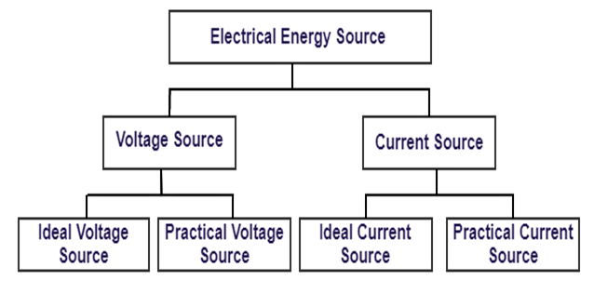
Types of Sources
There are different types of sources such as:
Fig. 10 types of sources
https://dipslab.com/concepts-electrical-circuit/

Slide 23
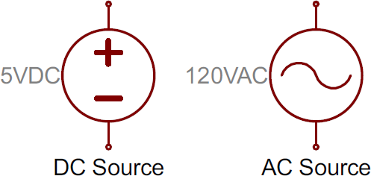
Voltage Source
It is as a battery or generator, provides a potential difference (voltage) between two points within an electrical circuit allowing current to flowing around it.
A battery is the most common voltage source for a circuit with the voltage that appears across the positive and negative terminals of the source being called the terminal voltage.
Fig.11 voltage sources
https://electronics.stackexchange.com/questions/306246/eagle-library-for-schematics-drawing

Slide 24
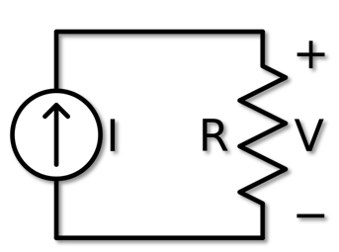
Current Source
A current source is an active circuit element that is capable of supplying a constant current flow to a circuit regardless of the voltage developed across its terminals.
A current source is an electronic circuit that delivers or absorbs an electric current which is independent of the voltage across it.
Fig. 12 current source
https://en.wikipedia.org/wiki/Current_source

Slide 25
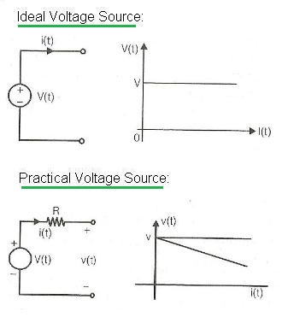
Ideal and Practical Voltage Source
Ideal voltage source: An ideal voltage source is defined as a two terminal active element that is capable of supplying and maintaining the same voltage (v) across its terminals regardless of the current (i) flowing through it.
Then an ideal voltage source is known as an Independent Voltage Source as its voltage does not depend on either the value of the current flowing through the source.
Fig. 13 ideal and practical voltage source
https://www.rfwireless-world.com/Terminology/Current-source-vs-Voltage-source.html

Slide 26
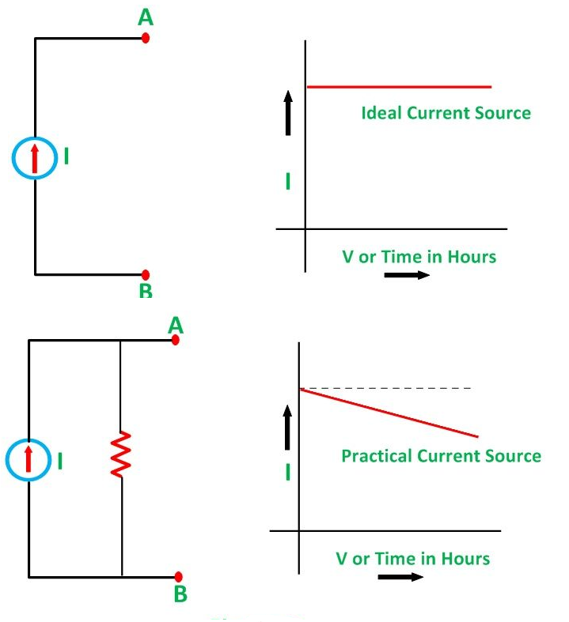
Ideal and Practical Current Source
Ideal current source: An ideal current source is a current source that supplies constant current to a circuit despite any other conditions present in the circuit.
An ideal current source generates a current that is independent of the voltage changes across it.
Fig.14 ideal and practical current source
https://circuitglobe.com/voltage-source-and-current-source.html

Slide 27
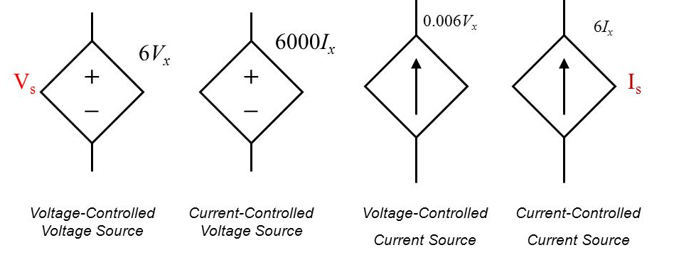
Dependent Source
Dependent Source: A dependent source is a voltage source or a current source whose value depends on a voltage or current elsewhere in the network.
Some voltage (current) sources have their voltage (current) values varying with some other variables.
They are called dependent voltage (current) sources or controlled voltage (current) sources.
Fig. 15 dependent source
https://slideplayer.com/slide/10541158/

Slide 28
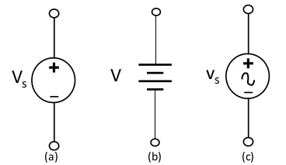
Independent Source
Independent Source: Independent Sources are the sources, whose output value does not depend upon the circuit parameters like voltage and current.
An independent voltage source maintains a voltage which is not affected by any other quantity.
Similarly an independent current source maintains a current (fixed or time-varying) which is unaffected by any other quantity.
Fig. 16 independent source
https://www.slideshare.net/3dadmin/electrical-circuit-lecture

Slide 29
Applications of AC Supply
Electric motors
Generators
Refrigerators
Dishwashers
Transformers
Washing machines
Drilling machines

Slide 30
Applications of DC Supply
Cell phones
Flashlights
Flat screen TVs (AC goes into TVs and then converted into DC)
Electric vehicles
Solar PV system
Laptops

Slide 31
Advantages of AC Circuit Over DC Circuit
AC is easier than DC supply and easy to generate.
AC can be transferred to over long distances as compared to DC.
Power loss in AC supply is less as compared to DC supply during transmission.
AC can be easily converted into DC.
AC generators have higher efficiency than DC generators.

Slide 32
Ohm’s Law
When an electric potential difference (V) is applied across a conductor as shown in the figure below, some current (I) flows through it.
The flow of current is opposed by the resistance of the conductor and circuit.
Ohm’s laws state that the current through any two points of the conductor is directly proportional to the potential difference applied across the conductor, provided physical conditions i.e. temperature, etc. do not change. It is measured in (Ω) ohm.

Slide 33
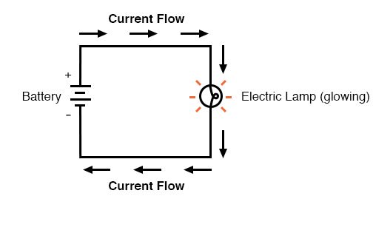
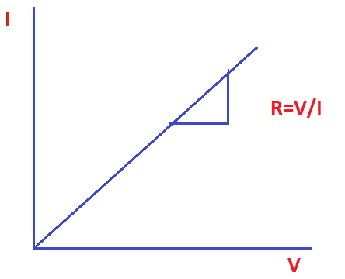
Ohm’s Law
Fig. 17 DC circuit
Fig. 18 Ohm’s Law curve
https://www.allaboutcircuits.com/textbook/direct-current/chpt-2/voltage-current-resistance-relate/
https://www.electrical4u.net/electrical-basic/ohms-law-simple-concept-eee-student/

Slide 34
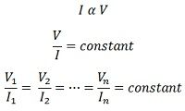
Ohm’s Law
Mathematically it is expressed as:
In other words, Ohm’s law can also be stated as;
Hence ratio of voltage and current is always equal when physical conditions are constant.
…………………………….(1)
…………………………….(2)

Slide 35


Ohm’s Law
This constant is also called the resistance (R) of the conductor (or circuit).
It can be written as
In a circuit, when current flows through a resistor, the potential difference across the resistor is known as voltage drops across it, i.e., V = IR.

Slide 36
Limitations of Ohm’s Law
Not applicable in unilateral networks.
It is not applicable for the non-linear network.
Their parameter likes resistance, inductance, capacitance and frequency, etc., not remain constant with the times.
So ohms law is not applicable to the nonlinear network.

Slide 37
Summary
Introduction to dc and ac circuits.
Various types of elements.
Differentiation between ac and dc supply.
Different types of sources used in electric circuits.
Introduction to ohm’s laws and its limitations.

Slide 38
Frequently Asked Questions
What is the difference between ac and dc supply?
Give the difference between ideal and practical voltage source.
Which is more dangerous ac or dc supply?
Give statement of ohm’s law.
What are the applications of ohm’s law?

Slide 39
Practice Questions
In a circuit if supply voltage is 12 volt and current is 4A so what will be the resistance of entire circuit?
Judge the location of I-V curve when we have fixed resistance of 5ohm, 15ohm, 25ohm.
In a heater it takes 2A current in a coil when we give 100 volte supply what will be the resistance of coil?
Evaluate the voltage drop across a toaster of 2kW which draws 3A of current.

Slide 40

LEARNING OUTCOMES
To make students understand
Concepts of electricity and relate them to practical engineering systems.
Importance of comprehension of electrical systems from electrical safety point of view.
Fundamentals of electric current and its associated quantities.

Slide 41
Course Outcome to Program Outcome Relationship
 |  | (21ELH-101) BEEE
PO→
CO↓ | PO1 | PO2 | PO3 | PO4 | PO5 | PO6 | PO7 | PO8 | PO9 | PO10 | PO11 | PO12 | PSO1 | PSO2 | PSO3
CO1 | 3 | 2 |  |  |  |  |  |  |  |  |  |  | 3
CO2 | 3 | 2 |  |  |  |  |  |  |  |  |  |  | 3
CO3 | 3 | 2 |  |  |  |  |  |  |  |  |  |  | 3
CO4 | 3 | 2 |  |  |  |  |  |  |  |  |  |  | 3
CO5 | 3 | 2 |  |  |  |  |  |  |  |  |  |  | 3

Slide 42
Assessment Pattern
A Assignment (each assignment) | B Time Bound Surprise Test (each test) | C Quiz (each quiz) | D Mid Semester Test(one per test) | E Homework | F Discussion Forums | G Attendance and engagement Score on BB
10 | 12 | 4 | 20 | NA | NA | 2

Slide 43
References
Textbooks of Basic Electrical & Electronics Engineering:
Fundamentals of Electrical Circuits by Charles k.
Electrical Technology by Surinder Pal Bali, Pearson Publications.
Websites:
https://www.electronics-tutorials.ws/dccircuits/dcp_4.html
https://circuitglobe.com/independent-dependent-voltage-and-current-source.html
https://circuitglobe.com/voltage-source-and-current-source.html
https://www.electrical4u.com/electrical-engineering-articles/basic-electrical/

Slide 44
THANK YOU
For queries
Email: akhilnigam.eee@cumail.in

